Slide 1


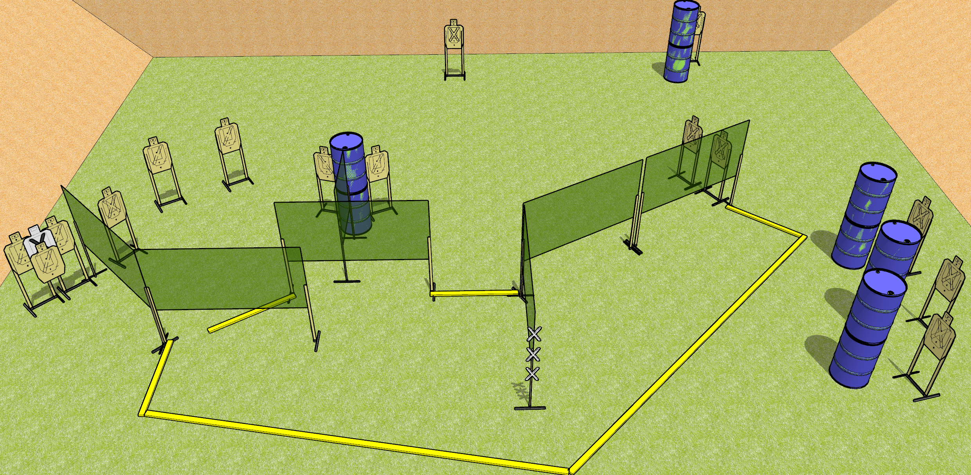
 | Dothan Gun Club – USPSA Match Get Going Course Designer : Drew Coleman
START POSITION : Standing with both hands touching marks, PCC SHOULDERED with muzzle touching a mark.
GUN READY CONDITION : Pistol loaded and holstered. PCC SHOULDERED muzzle touching a mark. |  | SCORING: Comstock, 30 rounds TARGETS: 15 paper, 0 Steel SCORED HITS: Best 2 on paper, steel until down START-STOP: Audible, last shot RULES:
STAGE PROCEDURE: Engage targets as they become available from within the fault lines

